Slide 1
Digital Portfolio
STUDENT NAME:JASMIME.M.B
REGISTER NUMBER AND NM ID:ASBRU3J2422K0959
DEPARTMENT: COMPUTER SCIENCE
COLLEGE AND UNIVERSITY: TIRUPUR KUMARAN COLLEGE FOR WOMEN BHARATHIYAR UNIVERSITY

Slide 2
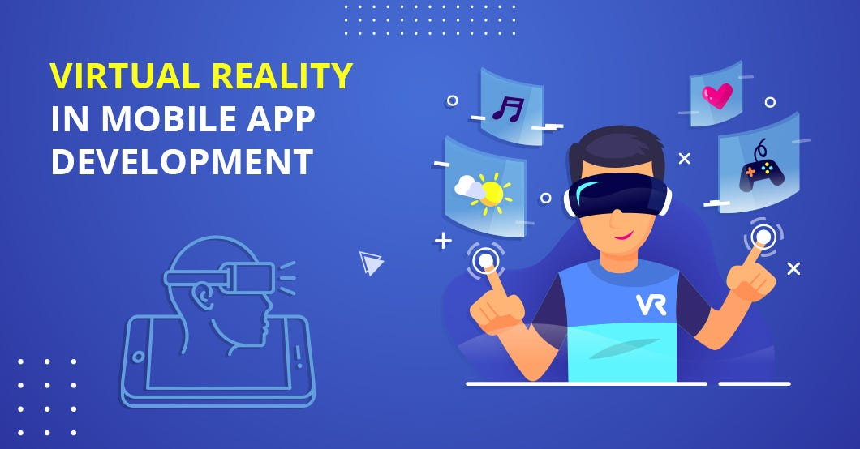
PROJECT TITLE

Slide 3


AGENDA
Problem Statement
Project Overview
End Users
Tools and Technologies
Portfolio design and Layout
Features and Functionality
Results and Screenshots
Conclusion
Github Link
3/21/2024 Annual Review

Slide 4

PROBLEM STATEMENT
A clear and concise description of the problem or challenge that a project aims to address. It defines the specific issue, need, or opportunity that the project seeks to solve or capitalize on. A problem statement typically includes:
- Description of the problem or challenge
- Impact or consequences of not addressing the problem
- Target audience or stakeholders affected by the problem
- Potential benefits of solving the problem
A well-defined problem statement provides a foundation for the project's objectives, scope, and approach, ensuring that the solution meets the needs and expectations of the target audience.

Slide 5

PROJECT OVERVIEW
A summary of the key aspects of a project, providing a concise and comprehensive understanding of the project's objectives, scope, approach, and expected outcomes. A project overview typically includes:
- Project goals and objectives
- Description of the project's scope and deliverables
- Methodologies and approaches used
- Technologies and tools employed
- Expected outcomes and benefits
- Target audience or stakeholders
A project overview serves as a high-level introduction to the project, providing stakeholders with a quick understanding of the project's purpose, scope, and expected impact. It helps to communicate the project's vision and objectives to team members, stakeholders, and sponsors.

Slide 6

WHO ARE THE END USERS?
The individuals or groups who will ultimately interact with, use, or benefit from the project or product. End users are the target audience for whom the project is designed, and their needs, goals, and behaviors are a key consideration in the project's development. Examples of end users might include:
- Potential employers or clients viewing a portfolio
- Customers using a product or service
- Students or learners interacting with an educational platform
- Professionals utilizing a tool or software
Understanding the needs, preferences, and pain points of end users is crucial to designing and developing a project that meets their expectations and provides value.

Slide 7
TOOLS AND TECHNIQUES
The software, hardware, methodologies, and approaches used to design, develop, and deliver a project. Tools and techniques can include:
- Programming languages and frameworks (e.g., JavaScript, A-Frame, Three.js)
- Development software and platforms (e.g., Blender, Unity)
- Design and prototyping tools (e.g., Figma, Adobe XD)
- Project management methodologies (e.g., Agile, Scrum)
- Testing and debugging techniques
The choice of tools and techniques depends on the project's requirements, goals, and scope. Effective use of tools and techniques can help ensure the project is completed efficiently, meets its objectives, and delivers high-quality results. In the context of the VR portfolio project, tools and techniques might include A-Frame, WebVR, HTML, CSS, and JavaScript.

Slide 8
POTFOLIO DESIGN AND LAYOUT
The visual arrangement and organization of content in a portfolio, including the selection of colors, typography, imagery, and other design elements. A well-designed portfolio layout effectively communicates the creator's message, showcases their work, and provides an engaging user experience. Key aspects of portfolio design and layout include:
- Visual hierarchy and composition
- Color scheme and typography
- Imagery and graphics
- Navigation and interaction design
- Responsiveness and adaptability
In the context of a VR portfolio, design and layout considerations might also include:
- 3D modeling and spatial arrangement
- Immersive and interactive elements
- User experience and navigation in VR space
A well-designed portfolio layout can help showcase one's skills, creativity, and professionalism, making a strong impression on viewers.
‹#›

Slide 9
FEATURES AND FUNCTIONALITY
The specific capabilities, characteristics, and interactive elements of a project or product that enable users to achieve their goals and have a meaningful experience. Features and functionality can include:
- Interactive elements (e.g., buttons, menus, animations)
- Content presentation (e.g., text, images, videos, 3D models)
- Navigation and exploration (e.g., menus, links, spatial navigation)
- User engagement (e.g., feedback mechanisms, gamification)
- Technical capabilities (e.g., VR/AR integration, responsive design)
In the context of a VR portfolio, features and functionality might include:
- Interactive 3D models and environments
- Immersive storytelling and narrative elements
- User-controlled navigation and exploration
- Dynamic content and real-time rendering
Well-designed features and functionality can enhance the user experience, engage the audience, and effectively communicate the creator's message.

Slide 10
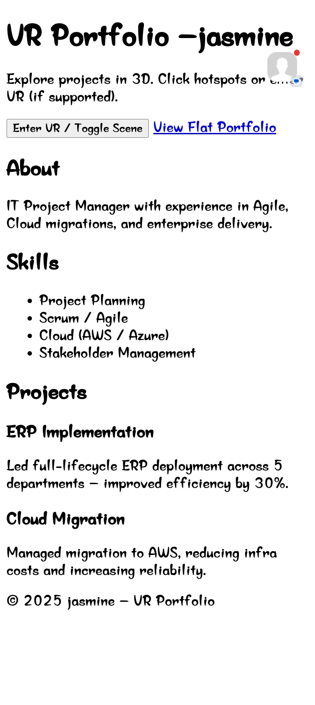
RESULTS AND SCREENSHOTS
3/21/2024 Annual Review
‹#›

Slide 11
CONCLUSION
A summary of the key points, outcomes, and takeaways from a project, highlighting its achievements, lessons learned, and potential future directions. It provides a final assessment of the project's success in meeting its objectives and delivering value to users or stakeholders. A conclusion often reflects on the project's impact, identifies areas for improvement, and may outline potential next steps or applications. It serves as a closing statement that reinforces the project's significance and leaves a lasting impression on the audience. A well-crafted conclusion effectively wraps up the narrative and leaves the viewer with a clear understanding of the project's accomplishments and value.
‹#›

